Slide 1
Operations Modelling Challenge
Sri RamaJayam
Organized by OpperHeimer – Optima – IITKGP – ORMAE
Presented By:
Hariharan Subramanian – SASTRA University
SSVKSS JyothirAditya -IIT Kharagpur
GitHub Link : https://github.com/shariharan2002/Heterogenous-Fleet-and-Commodity-VRP/

Slide 2
Intro to the problem statement
We are given a set of refineries(oil production centres), oil depots(oil demand centres) with variable demands.
We are given different types of products, which are being produced in variable quantities
We are also given various types of vessels, each with different capacities and costs of travel.

Slide 3
Our Approach
We saw existing papers in the literature and found one paper that closely resembled the problem statement given.
The paper had implemented A branch and Price algorithm for Heterogenous Fleet MultiDepot-MultiTrip Vehicle Routing Problem With Time Windows
We removed the time windows capability and extended the formulation to add Heterogenous commodities
However, we were unable to extend the formulation to account for >1 product within a single vessel
We also did not delve into advanced Integer programing techniques(like branch and price, or column generation).
Instead for classic MIP problems, we chose to stick with the CPLEX branch and bound solver due to shortage of time.

Slide 4
Aim and Assumptions
Aim: To find sets of trips that both start and end at refineries with minimum cost.
Assumptions:
Set of trips should satisfy that each depot is visited only once for each commodity type.
Total demand of depots in a trip should not exceed the vessel capacity.
Capacity consumption of a vessels assigned to refinery should not exceed the refinery capacity.
Trips can start and end at any refinery
Each vessel is allowed to perform several trips, and can start and end each of its trips at any refinery.
The no. of vessels for each vessel type at each refinery is assumed to be unlimited. No. of vessels can be limited using a procurement cost per vessel.
No. of vessels at each depot at start and end of workday should remain the same

Slide 5
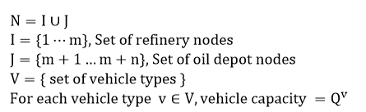
Notation and Terminology

Slide 6

Notation and Terminology
$q_{j,c}$ : Each depot node $j∈J$, has a demand for commodity $c∈C$ as
$V_{j,c}$ : For each depot node $j∈J$, the set of vessels that can serve depot $j$ for commodity $C∈C$ is given by:
$$V_{j,c}=\left\{v∈V∣q_{j,c}≤Q^{v}\right\}$$

Slide 7
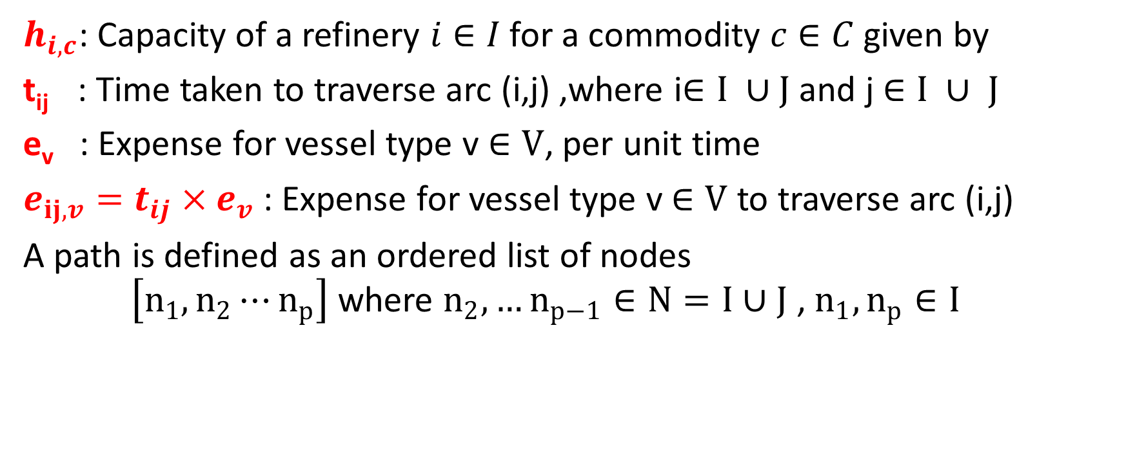
Notation and Terminology
$h_{i,c}$: Capacity of a refinery $i∈I$ for a commodity $c∈C$ given by
t_{ij} : Time taken to traverse arc (i,j) ,where i$∈I ∪J$ and j $∈I ∪ J$
e_{v} : Expense for vessel type v $∈V$, per unit time
$e_{ij,v}=t_{ij}×e_{v}$ : Expense for vessel type v $∈V$ to traverse arc (i,j)
A path is defined as an ordered list of nodes $\left[n_{1},n_{2}⋯n_{p}\right]$ where $n_{2},…n_{p−1}∈N=I∪J$ , $n_{1},n_{p}∈I$

Slide 8

Notation and Terminology
Let all paths belong to a global path set P
The set of feasible paths for vessel type v $∈V, commodity type c ∈C$ is given by $P_{v,c}$

Slide 9
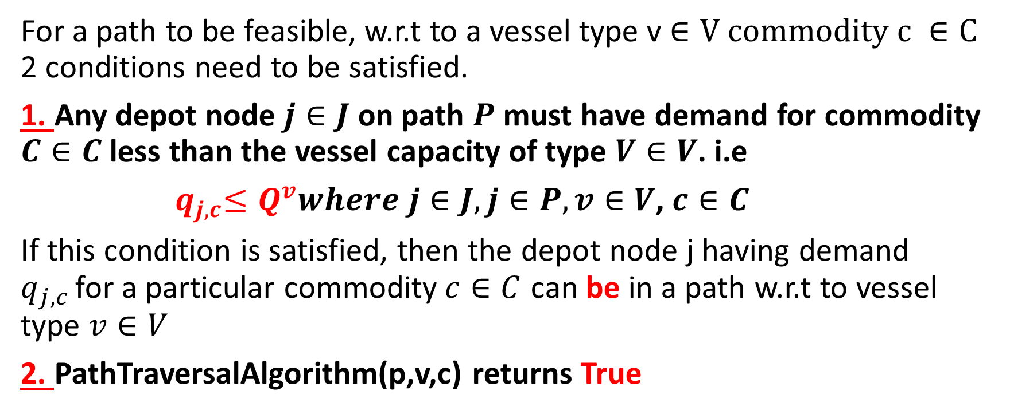
Defining the feasibility of a path
For a path to be feasible, w.r.t to a vessel type v $∈V$ $commodity c ∈C$ 2 conditions need to be satisfied.
1. Any depot node $j∈J$ on path $P$ must have demand for commodity $C∈C$ less than the vessel capacity of type $V∈V$. i.e
${ q}_{j,c}≤Q^{v}where j∈J,j∈P, v∈V$, $c∈C$
If this condition is satisfied, then the depot node j having demand $q_{j,c }$for a particular commodity$c∈C$ can be in a path w.r.t to vessel type $v∈V$
2. PathTraversalAlgorithm(p,v,c) returns True

Slide 10
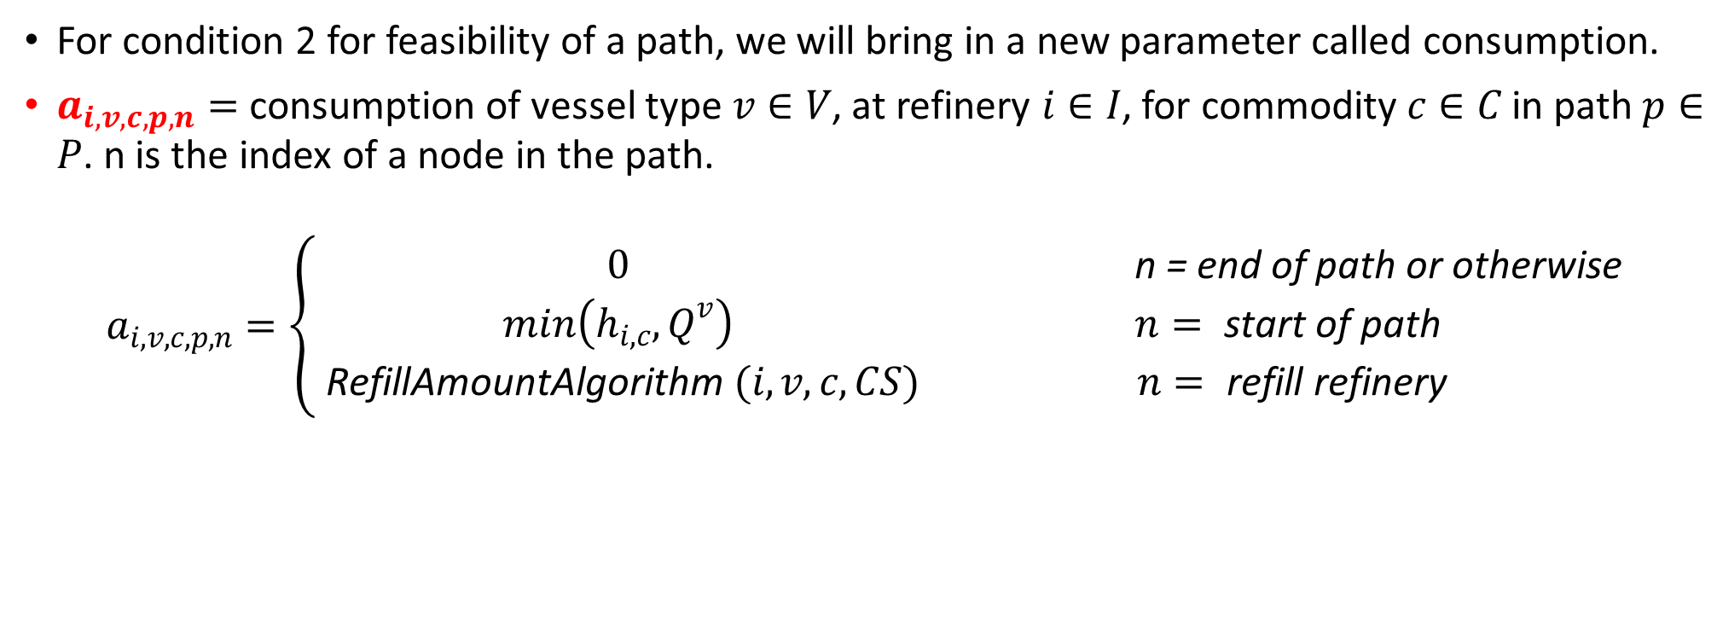
Consumption Parameter
For condition 2 for feasibility of a path, we will bring in a new parameter called consumption.
$a_{i,v,c,p,n}=$ consumption of vessel type $v∈V$, at refinery $i∈I$, for commodity $c∈C$ in path $p∈P$. n is the index of a node in the path.
$$a_{i,v,c,p,n}=\left\{\begin{matrix}0 & \text{n} \text{=} \text{end} \text{of} \text{path} \text{or} \text{otherwise} \\ min\left(h_{i,c},Q^{v}\right) & n= \text{start} \text{of} \text{path} \\ \text{RefillAmountAlgorithm} (i,v,c,CS) & n= \text{refill} \text{refinery}\end{matrix}\right.$$

Slide 11
How does the consumption parameter work?
Start of a path: We refill to the entire capacity of vessel. There might be a possibility when the vessel s’ capacity might exceed the refinery s’ capacity. In these cases, we fill the vessel with the entire refinery s’ capacity, thus emptying the refinery. In other cases, we consume only that amount from the refinery, that will make our vessel full.
End of a path: This means our trip has ended and we shall not refill.
Middle of a path: We have encountered a refinery node, then there is a scope for refill. The amount to be refilled is given by RefillAmountAlgorithm.

Slide 12
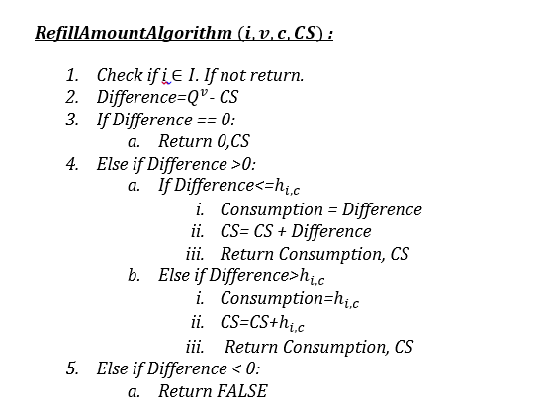
RefillAmountAlgorithm

Slide 13
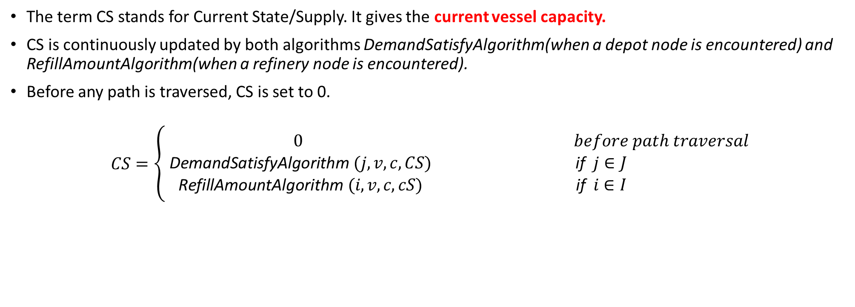
Current State/Supply
The term CS stands for Current State/Supply. It gives the current vessel capacity.
CS is continuously updated by both algorithms DemandSatisfyAlgorithm(when a depot node is encountered) and RefillAmountAlgorithm(when a refinery node is encountered).
Before any path is traversed, CS is set to 0.
$$CS=\left\{\begin{matrix}0 & before path traversal \\ \text{DemandSatisfyAlgorithm} (j,v,c,CS) & \text{if} j∈J \\ \text{RefillAmountAlgorithm} (i,v,c,cS) & \text{if} i∈I\end{matrix}\right.$$

Slide 14
The 3 Algorithms
The RefillAmountAlgorithm is encountered when a node is refinery node
The DemandSatisfyAlgorithm is encountered when a node is depot node
The PathTraversalAlgorithm traverses each node of the path and calls the appropriate algorithm based on type of node(refinery or depot)
CS is in fact updated by both DemandSatisfyAlgorithm and RefillAmountAlgorithm

Slide 15
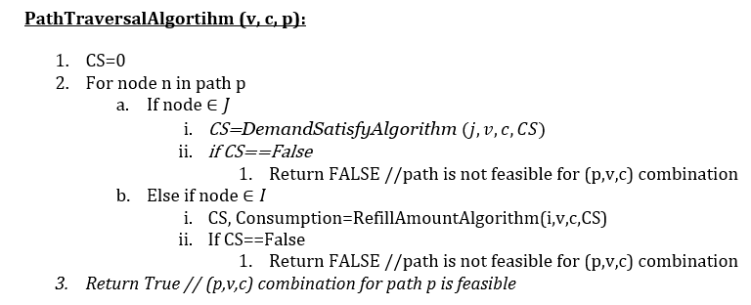
PathTraversalAlgorithm

Slide 16
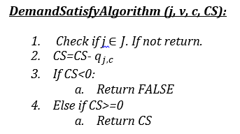
DemandSatisfyAlgorithm

Slide 17
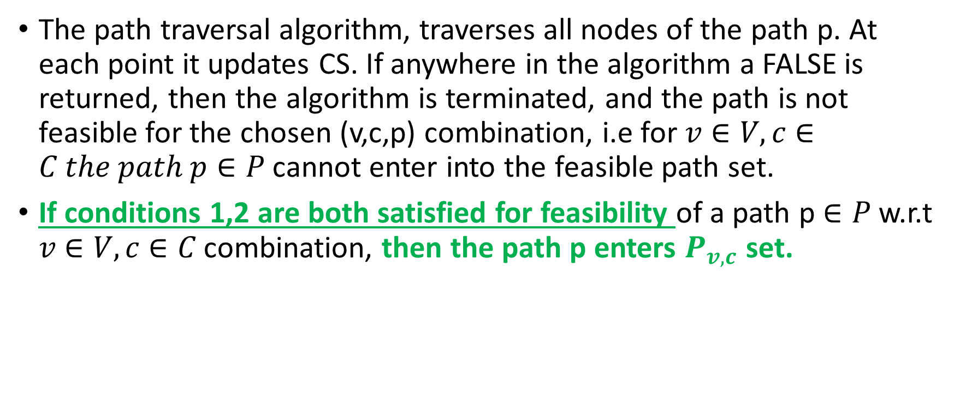
Back to path feasibility
The path traversal algorithm, traverses all nodes of the path p. At each point it updates CS. If anywhere in the algorithm a FALSE is returned, then the algorithm is terminated, and the path is not feasible for the chosen (v,c,p) combination, i.e for $v∈V, c∈C the path p∈P$ cannot enter into the feasible path set.
If conditions 1,2 are both satisfied for feasibility of a path p $∈P$ w.r.t $v∈V, c∈C$ combination, then the path p enters $P_{v,c}$ set.

Slide 18
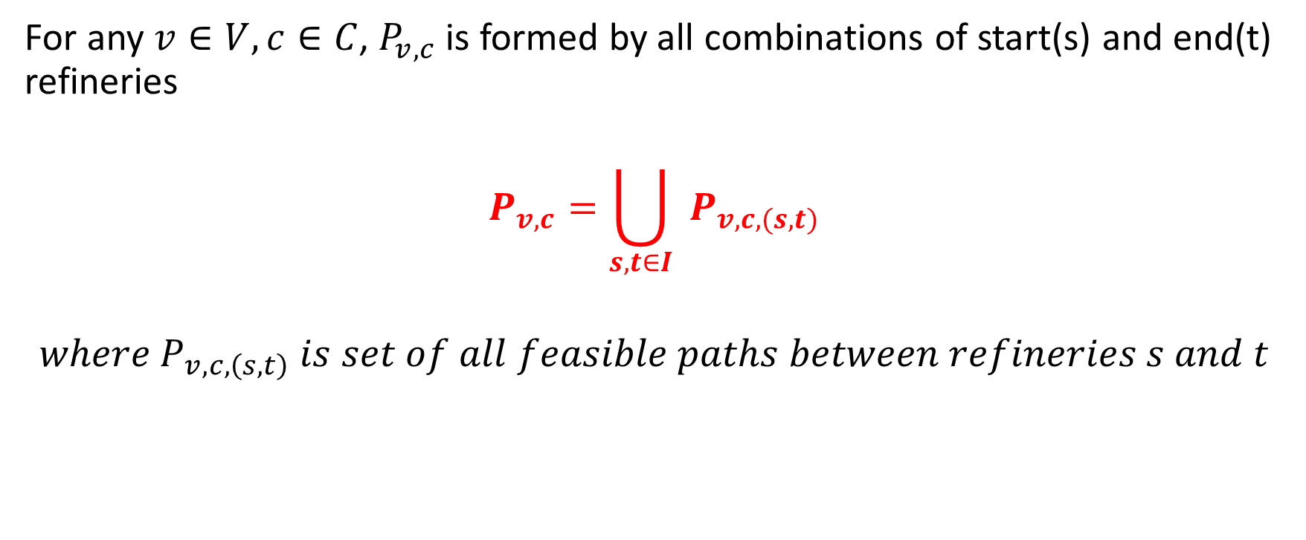
Path feasibility between any 2 refineries
For any $v∈V, c∈C$, $P_{v,c}$is formed by all combinations of start(s) and end(t) refineries
$$P_{v,c}=\bigcup_{s,t∈I}{ }P_{v,c,(s,t)}$$
$${where P}_{v,c,\left(s,t\right)} is set of all feasible paths between refineries s and t$$

Slide 19

Expense of a path
Expense of a path $Δ_{v,c,p}$ is defined as:
$$Δ_{v,c,p}=\sum{ }e_{ij,v}$$
Where ij is arc present in path p$∈P_{v,c}$ $,v∈V, c∈C$

Slide 20
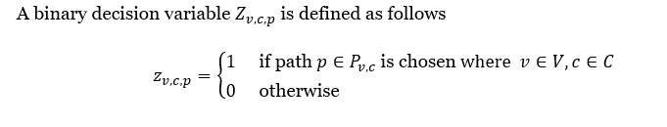
Decision Variable

Slide 21
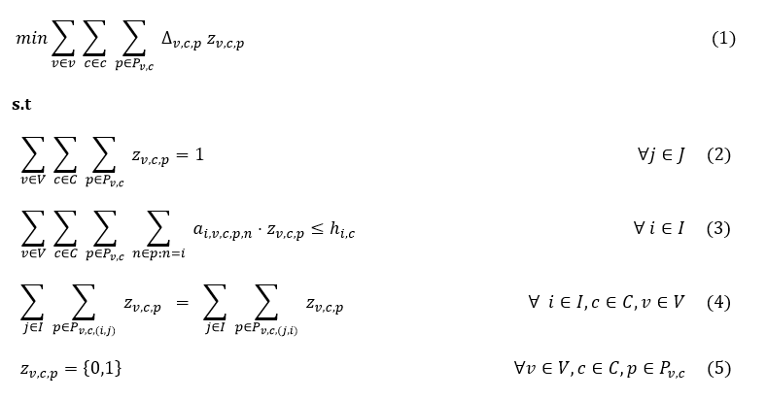
Integer Program Formulation

Slide 22

Objective Function
Defines the objective function and minimizes the overall routing cost

Slide 23

Depot should be visited once
Imposes that for each depot, for each commodity type, the depot node should be visited only once

Slide 24

Capacity of Refinery not exceeded
Ensures that total capacity consumption of vessels assigned to a refinery does not exceed the refinery capacity

Slide 25

Balance of Vehicle types at each Refinery
Ensures that the total no. of vessels per vessel type remain the same at each refinery at the start and end of workday

Slide 26
Can we make consumption parameter more efficient?
Yes we can, for this we build another algorithm – RemainingDemand Algorithm
Using this algorithm, the vessel only consumes that amount of material that is needed for the depot nodes remaining on its path

Slide 27
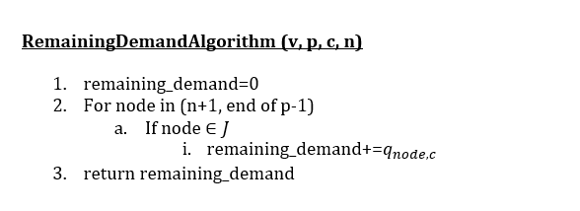

Slide 28

Consumption parameter changes as follows

Slide 29
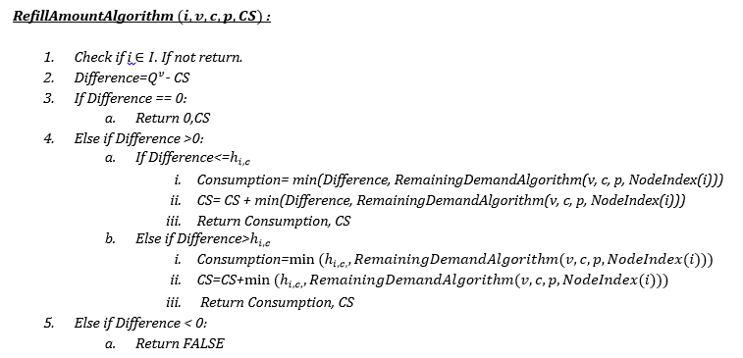

Slide 30
What might be the disadvantages?
We tune the consumption of a vessel at a refinery for a commodity manually using logical ideas. This may not entirely be optimal. The most optimal way would be to make the consumption parameter itself a decision variable and let the solver decide. However, with the given constraints, it might be possible that the formulation becomes non-linear(product of decision variables). Hence we chose to avoid this.
When we choose to change the consumption parameter from one feasible path to another feasible path based on various factors(in our case, CS, remaining demand and so on), the formulation cannot be easily extended to solve large scale problems. I.e when the consumption parameter is a constant, the pricing subproblem is SPPRC(Shortest path problem with Resource Constraints). But when it’s not a constant, all feasible paths need to be enumerated, and fast IP solving techniques like Column Generation and/or Branch and Price cannot be employed.
This is one of the main reasons that the author of the research paper chose to keep the consumption parameter constant so as to allow tractability.

Slide 31


Using old consumption parameter
Using new consumption parameter

Slide 32
